Slide 1
EXTERNAL EXAMINER INDUCTION
9 September 2025
Welcome - Session starting at 2 pm
The session will be recorded and made available to examiners unable to attend. Please let us know if you have any concerns.

Slide 2
Welcome
Steve King
Chair: Standing Committee on Assessment (SCA)
Aimee Yeoman
Secretary of SCA
Rebecca Millan
Administrator, Student & Academic Services Team

Slide 3
Your Role
You all play a critical role in assisting the University to discharge its responsibilities for Quality and Standards – Thank you!
Independent advice to us on academic standards & quality of assessment
Critical friend to the department & University
Advocate in the students’ learning experience
Notes:
Verify the appropriateness and comparability of standards and the fairness and rigour of the assessment process based on an agreed sample of student output.
Report on the quality of the assessments, standard and accuracy of marking, and conduct of the assessment process generally.
Offer suggestions to enhance the process of assessment and the quality of the learning opportunities.

Slide 4
University assessment policies and procedures
Please note, the 25-26 policies and procedures are due to be published for w/c 15th Sept 2025. Therefore, references on slides are for the 24-25 version
Includes:
Rules on Progression and Award for each award
Policy on Assessment, Examiners, Marking and Feedback
Board of Examiners (p.31)
External Examiners (p.34)
Standard and Marking (p.66)
Feedback (p.73)
https://www.york.ac.uk/staff/teaching/learning-design/assessment/guide/

Slide 5
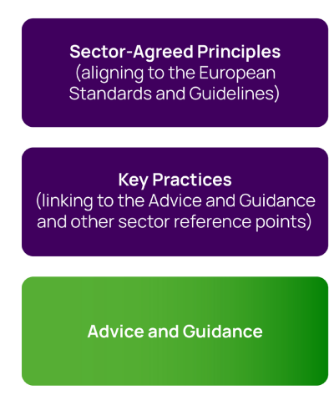
Your Role
Help us meet our our crucial obligations as a degree-awarding body.
UK Quality Code for Higher Education 2024
Notes:
Principle 6, on Engaging in External Review and Accreditation, but also under Monitoring and Enhancement (5)

Slide 6
Your Role: Maintaining academic standards
Feedback on whether:
The programme and its components continue to be coherent, their outcomes aligned with the relevant qualification descriptor in the applicable qualifications framework, and any relevant subject benchmark statements.
The programme reflects any additional PSRB requirements.
Assessments in modules of the same level are of a comparable standard and the curriculum remains current.
Assessment criteria, marking schemes and arrangements for classification are set at the appropriate level.
Notes:
Feedback on whether:
the programme and its component parts continue to be coherent and their outcomes aligned with the relevant qualification descriptor set out in the applicable qualifications framework, supplemented where applicable by one or more subject benchmark statements (These are primarily for undergraduate programmes with some postgraduate ones).
the programme reflects any additional PSRB requirements
assessments in modules of the same level are of a comparable standard the curriculum remains current
assessment criteria, marking schemes and arrangements for classification are set at the appropriate level.

Slide 7
Your Role: Measuring achievement, rigour and fairness
Feedback on whether:
The types of assessment are appropriate for the subject, the students, the respective level of study and the expected outcomes.
The marking scheme/grading criteria have been properly and consistently applied, and internal marking is of an appropriate standard, fair and reliable.
The assessment processes are carried out in accordance with the degree-awarding body's regulations and procedures.
Procedures governing exceptional circumstances, academic integrity/misconduct and borderline performances have been considered fairly and equitably applying institutional regulations.
Notes:
Feedback on whether:
the types of assessment are appropriate for the subject, the students, the respective level of study and the expected outcomes
the marking scheme/grading criteria have been properly and consistently applied, and whether internal marking is therefore of an appropriate standard, fair and reliable
the assessment processes are carried out in accordance with the degree-awarding body's regulations and procedures
procedures governing exceptional circumstances affecting assessments, academic integrity/misconduct and borderline performances have been considered fairly and equitably applying institutional regulations.

Slide 8
Your Role
Information available to you (see Policy of Assessment, Examiners, Marking and Feedback 2024/5, 8.4 The responsibilities of External Examiners)
Syllabus, handbooks, reports
Meeting with students (?)
Receiving assessment tasks in advance (e.g. exams)
Assessment/marking schemes
Student work and feedback on work
Exam boards data and processes

Slide 9
We will ask you to:
Comment on draft exams and other forms of assessment
Review (sampled) examination scripts
Review other student work
Attend Exam Boards (see later)
Advise on programme enhancements and new programme proposals as requested
Make improvement/ enhancement suggestions
Submit annual report
Work with the department to help maintain standards and foster excellence.
Notes:
External examiners can be asked if they would comment on new programme proposals relevant to their area of expertise (following a change in rules that allows external examiners to be external assessors of proposals).

Slide 10
Exam Boards:
Scrutiny Panel (following each Assessment Period)
Receives marks, checks penalties, considers assessment issues, recommendation for scaling etc)
Departmental Exam Board (Module Board)
Finalises marks for modules, input from External Examiners
External Examiners: please provide an oral report
Ratification Panel
Confirms and ratifies outcomes for progression and award.

Slide 11
Exam Boards:
We will ask you to:
Approve processes
Confirm standards, fairness and rigour
Consider outcomes
Approve final marks
Comment and advise on all aspects (and we will listen!)
We will NOT ask you to:
Mark work
Consider an individual student’s circumstances.

Slide 12
SCENARIOS

Slide 13
BREAK

Slide 14
University assessment policies and procedures
Please note, the 25-26 policies and procedures are due to be published for w/c 15th Sept 2025. Therefore, references on slides are for the 24-25 version
Includes:
Rules on Progression and Award for each award
Policy on Assessment, Examiners, Marking and Feedback
Board of Examiners (p.31)
External Examiners (p.34)
Standard and Marking (p.66)
Feedback (p.73)
https://www.york.ac.uk/staff/teaching/learning-design/assessment/guide/

Slide 15
University of York Progression & Award Rules - Undergraduate Programmes
Based on credit weighted average (rounded to nearest integer)
First-class Honours average ≥70
Upper second-class Honours 60 ≤ average < 70
Lower second-class Honours 50 ≤ average < 60
Third-class Honours 40 ≤ average < 50
3-year Bachelors weighted 0:2:3
4-year Integrated Masters weighted: 0:2:3:3

Slide 16
University of York Progression and Award Rules - Undergraduate Programmes
Based on credit weighted average (rounded to nearest integer)
Borderline cases
Possible first-class Honours average ≥68
Possible Upper second-class Honours 58 ≤ average < 60
Possible Lower second-class Honours 48 ≤ average < 50
Possible Third-class Honours 38 ≤ average < 40
3-year Bachelors when weighted 0:1:1 OR 0:1:2
4-year Integrated Masters when weighted : 0:1:1:1 OR 0:1:2:2

Slide 17
University of York Progression and Award Rules - Postgraduate Taught (Masters)
Based on credit weighted average (rounded to nearest integer)
Distinction: average ≥70 and ≥70 on capstone project
Merit: average ≥60 and ≥60 on capstone project

Slide 18
University of York Progression & Award Rules - Compensation & Re-assessment Principles
Compensation allowed, but only if:
Stage average is at pass level, AND
A “compensatable fail” mark is achieved in all modules, AND
Maximum number of credits compensation not exceeded
Reassessment allowed, but only if:
Maximum credits of reassessment not exceeded, AND
Maximum credits of “outright fail” not exceeded
Module marks are "capped" after reassessment.

Slide 19

A useful guide
Advance HE’s handbook for external examining (Feb 2019) is a useful reference point

Slide 20

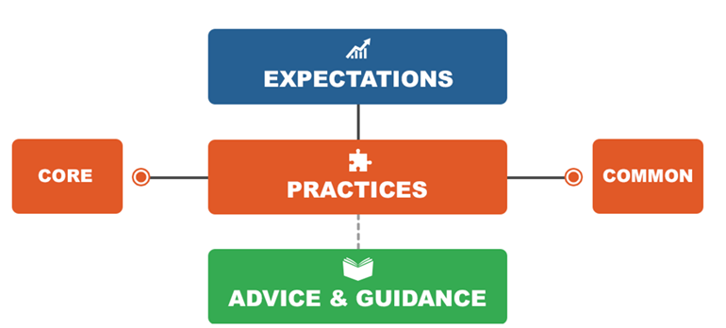
The Report
Purpose
Design of the template
Key features of a ‘good’ report
University’s quality assurance framework
Advice & Guidance on Externality yet to be published by QAA

Slide 21
The Report
Key feature of our annual monitoring and enhancement processes
Evidences comparability of our awards, appropriateness of standards, assessment process
Sector expectation
Designed in accordance with the guiding principles in Quality Code Advice and Guidance: External Expertise.
Notes:
Brief introduction to the report

Slide 22
Design Template
Reflection on Standards
comparability of standards (in context of other UK degree awarding bodies)
course structure & content (in context of the level of the qualification & benchmark statement)
marking scheme/grading criteria & extent to which it has been rigorously & consistently applied
threshold standards are met
Notes:
To assist the University in the comparison of academic standards of its award across the HE sector
To verify that standards are appropriate for the Awards or modules for which you take responsibility
To ensure that the assessment processes for marking, grading and classification of student performance are robust and consistent
To report on the standards of student achievement - threshold and above

Slide 23
Design Template
Reflection on Assessment
appropriateness of methods (for the subject, level, and learning outcomes)
conduct of the Board of Examiners (fair & equitable application of rules for assessment, progression, award etc)
effectiveness of administrative arrangements (e.g. time to review assessment sample).
Notes:
To provide assessment of the quality and suitability of assessment methods
To comment on the effectiveness and efficiency of processes
To comment on fairness, equitability and consistency of processes and application of rules (Uni and Dept, (eg. word length penalties)).
To comment on how you are supported to do your role
To identify, where appropriate, examples of good practice as well as areas for enhancement

Slide 24
Design Template
Reflection on quality of teaching and learning
(in so far as you are able) as revealed in assessments & by student performance.
Optional sections
Induction (first year of appointment)
End of term overview
Previous issues (considered & responded to?)
Additional comments
Feedback on the form.
Notes:
To provide comment, as far as practicable on the quality of teaching and learning (evidenced through work, but also any observations or meetings with students and staff)
Confirm that sufficient evidence was received to enable the role to be fulfilled (where evidence was insufficient, they give details):
State whether issues raised in previous reports have been, or are being, addressed to their satisfaction
Address any issues as specifically required by any relevant professional body
Give an overview of their term of office (when concluded)
Provide feedback to the University to improve the experience of external examiners.

Slide 25
Design Template - Assurance
Overall opinion on whether:
a) the standards set for this/these award(s) are appropriate for qualifications at this level, in this subject
YES/NO
b) the academic standards and the achievements of students are comparable with similar programmes or subjects in other UK degree-awarding bodies with which you are familiar
YES/NO
c) the processes for assessment, examination and the determination of awards are sound and fairly conducted in line with the University’s regulations and procedures:
YES/NO
Notes:
Key standards questions as a tick box. Be honest in completing this. If you raise sufficiently significant concerns in your reports be confident to say no here.

Slide 26
Reports should….
Be sufficiently detailed - Fully address each point on the template
Be constructively written – aid enhancement – identify possible actions
Observe confidentiality
Recognise and highlight good practice
Be submitted on time – if there is a delay, please keep us posted.
Notes:
Appreciated that you will provide feedback to departments, but this is your report to the University and so it is helpful to provide a suitably detailed answer to the questions asked.
Observing confidentiality is tricky - avoid highlighting individual students or staff members, though we appreciate the feedback about the conduct of Boards of Examiners, their chairs and administrative support and of programme teams.
On time – normally submitted no later than six weeks after the completion of the assessment process – in order to feed in to quality assurance process – although we would rather the report was complete with full and detailed responses and a little bit late!

Slide 27
Scrutiny of the Report
Department – Boards of Studies – Annual Review Process
Academic Quality Team – create a log of issues raised on which the Department must indicate actions taken in response
University – Standing Committee on Assessment and University Education Committee
Shared with Student Representatives.
Notes:
Two levels of scrutiny
Departmental level – the report is considered by Boards of Studies. Departmental Annual Review process also includes a critical reflection on your report and the comments made.
Academic Quality Team - read all the reports and create a log of issues which is shared with depts – who add responses to the log explaining what actions they will (and will not) take/ contextual explanations.
The logs are used to produce a summary report (one for UG and one for PG) which seeks to identify common themes which may indicate a university-level action is required (e.g. training) – this report is considered by the two university committees – SCA and UEC. (Note slight difference for HYMS for any of their externals).

Slide 28
Response to the Report
Department
response must address issues raised and indicate action(s) to be taken (or not) in response
monitored via routine quality assurance processes
indicate in subsequent report if unsatisfactory response.
University acknowledgement & thank you
further correspondence if serious concerns are raised.
Notes:
You can expect a minimum of two responses
EE view is not binding – but we would expect an explanation / rationale for not taking forward recommendations or suggestions.

Slide 29
Fees and Expenses
Fees:
  Fees are finalised each year on account of student numbers
  Fees are paid after receipt of the annual report
  PG Examiners need to complete a self-assessment tax return
Expenses:
Travelling & other reasonable expenses, if incurred, will be reimbursed
Expenses are paid on submission of a claim form (this should be submitted within 3 months of incurring the expense) and sent to examiners@york.ac.uk
Claim form and guidelines are on the UoY External Examiners web page.

Slide 30
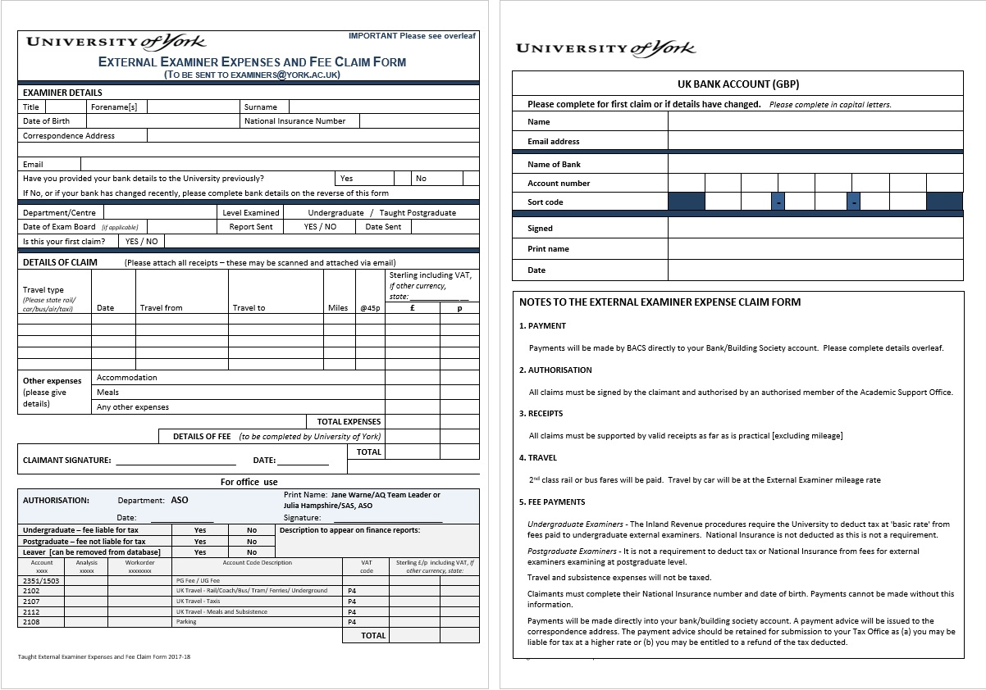

Slide 31
Any Questions?

Slide 32
Evaluation
We would greatly appreciate your feedback on this event to help us improve our delivery at future events. Would you please take a few minutes after this meeting to complete our evaluation form?

Slide 33
Contact Details
Email address: examiners@york.ac.uk
Website: External Examiners

